Slide 1
Networking Devices

Slide 2
Network interface: An active/intelligent device that interfaces or links the computer to the communication network.
Repeater: An active device that repeats (powering and reshaping) data signals for longer distances and has no logical function.
Hub: A passive device that links the trunk cable to the spurs, making a physical star network.
Switch: An active/intelligent device similar to the hub that routes or switches data to its destination.
Bridge: An active/intelligent device that links two networks of different characteristics such as speed, message format, etc.
Router: An active/intelligent device that links different networks and routes data around the network.
Gateway: An active/intelligent device that links one network to another with remote networks of different or dissimilar communications protocols

Slide 3
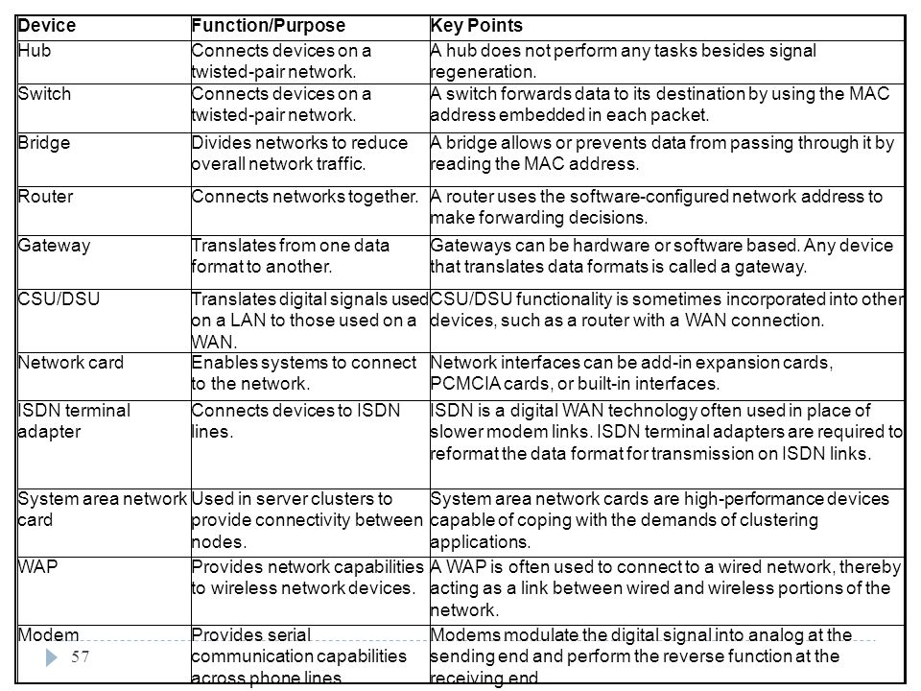

Slide 4
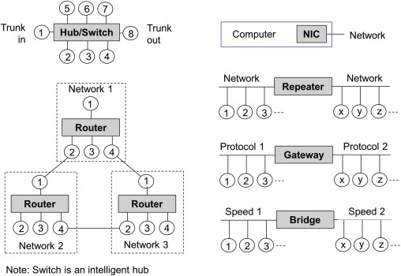

Slide 5
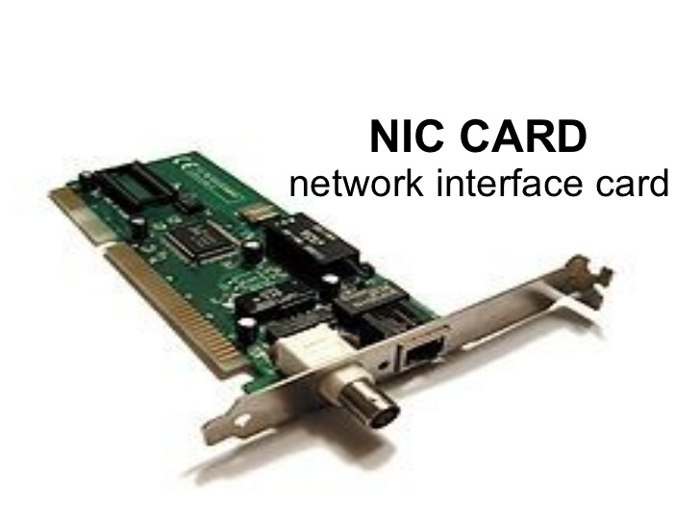

Slide 6
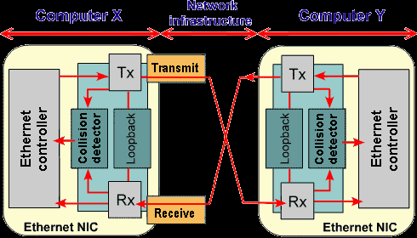

Slide 7
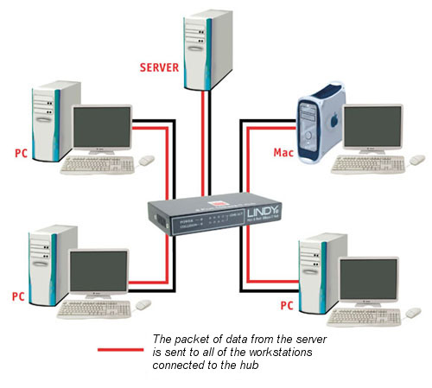

Slide 8
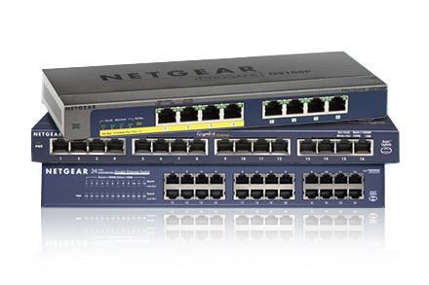

Slide 9
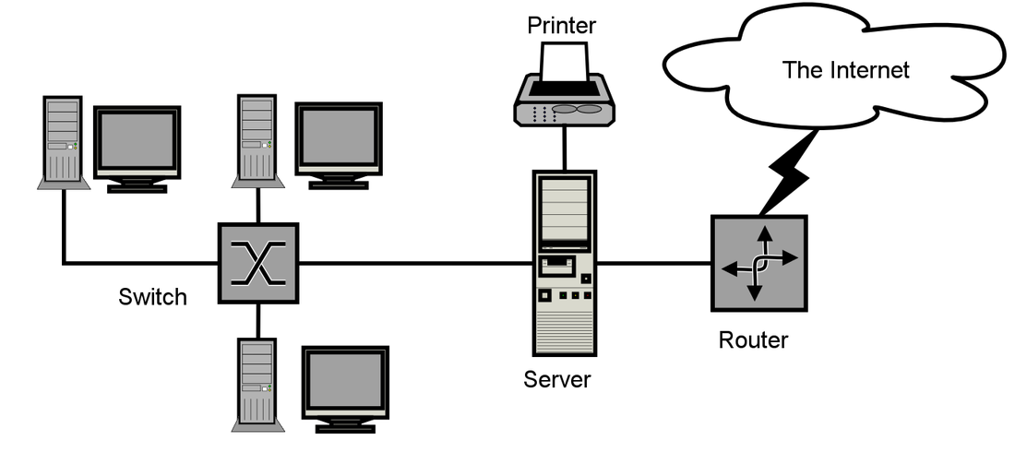

Slide 10
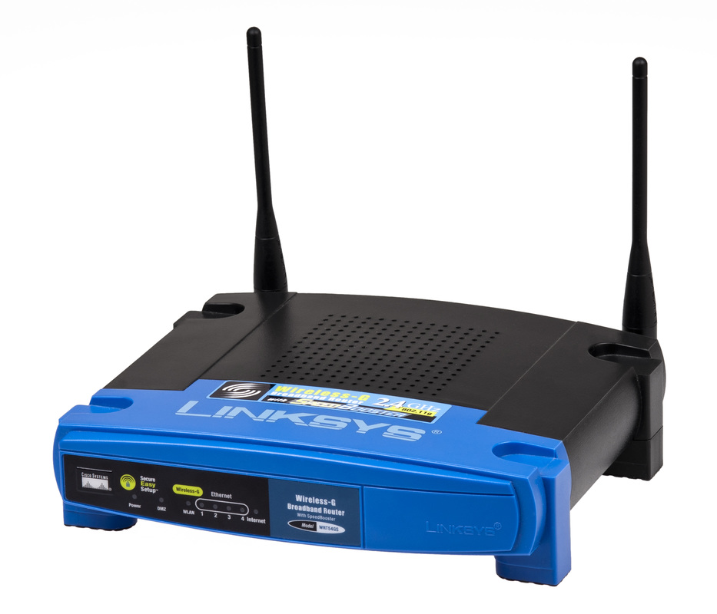

Slide 11
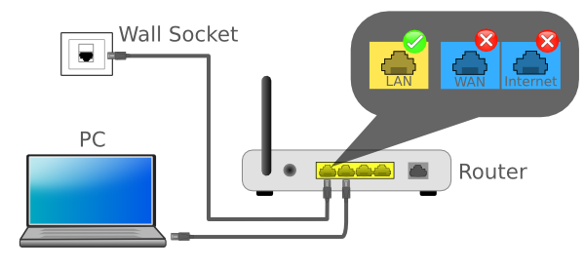

Slide 12
